Slide 1
Towards a Comprehensive and Continuously Updated
Swedish Cadastre
Kristin Land
Coordinator of Research and International Relations
Cadastral Services Division, Lantmäteriet, Sweden
PCC Conference, Riga, 12-13 May 2015

Slide 2

Two ongoing initiatives to meet the needs of the society
NDRK2017 – National Digital Cadastral Index Map 2017
KUF – Quality Development of Cadastral Data

Slide 3
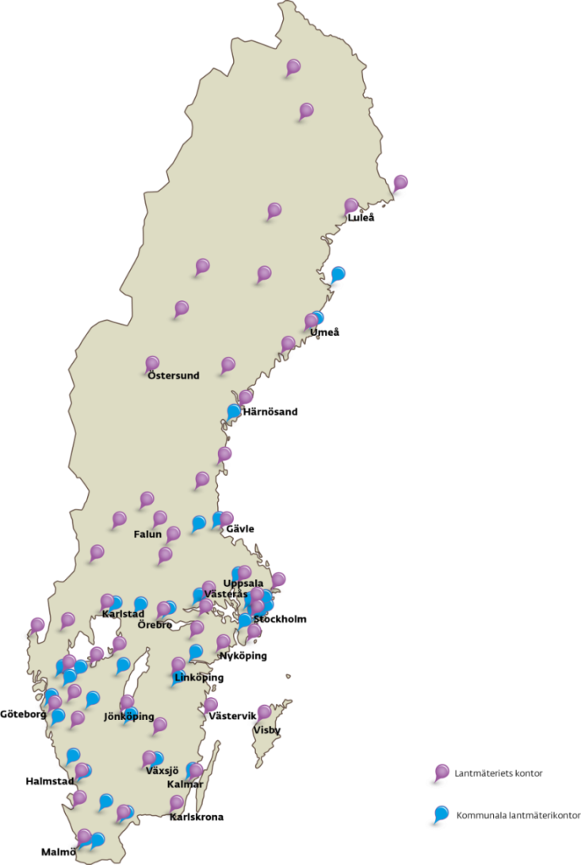
Cadastral organisation
Lantmäteriet’s Head Quarters
Advice and supervision regarding cadastral procedures and registration
Maintenance and improvement of
the Real Property Register (C+LR)
Lantmäteriet’s 50 cadastral offices
covering 251 municipalities
39 Municipal cadastral offices (independent)
covering one municipality each

Slide 4
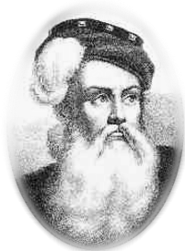
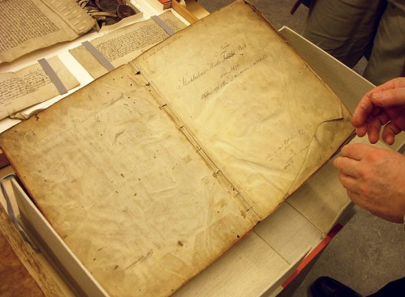
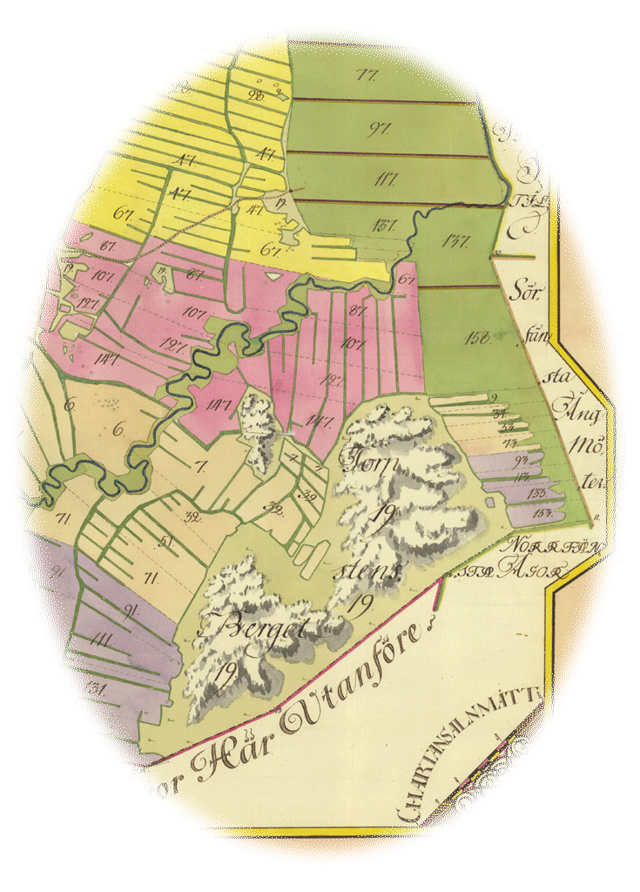
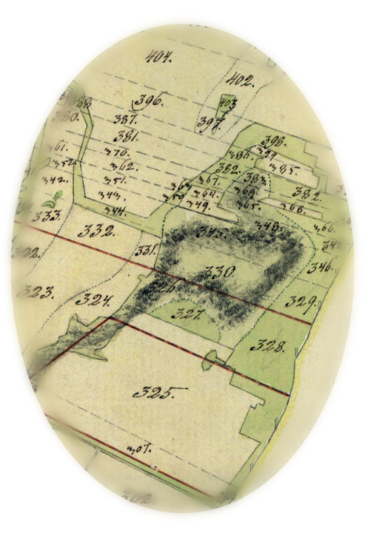
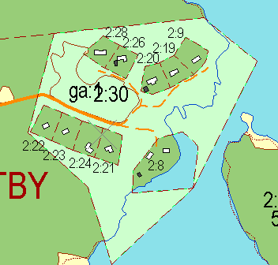
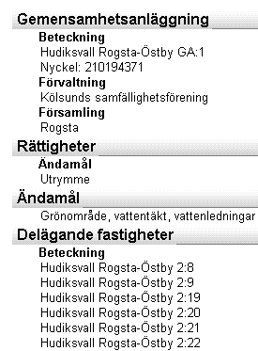
Development of the Real Property Register
Ready
1628-
mapping
1827-1926
land reform
1970-1995
digitalisation

Slide 5
NDRK2017
National Digital Cadastral Index Map 2017
Appropriation Direction from Swedish Gov. related to INSPIRE:
All data of the official Real Property Register to be kept by Lantmäteriet
Securing continuous updating of cadastral map data by the municipal cadastral authorities
Aligning textual and map information in the register
Deadline: 31st December 2017

Slide 6
Key players in NDRK2017
Lantmäteriet
Board,
Director General
Land & Geographic
Information
Cadastral
Services
Land
Registration
Cadastral
Services
Updating of register
39 Municipal
Cadastral Authorities

Slide 7
NDRK2017 aims
Continuous (daily) updating of the national cadastral map, to match the updating of the textual information
Focus objects: property units, use rights, development plans
Improved interface for data exchange based on two current system applications
No more local (neither analogue nor digital) cadastral maps kept by municipalities
Simplified user access to all registry data via Lantmäteriet
Changes in legislation required per 1st January 2018

Slide 8
Municipal cadastral authorities with continuous (daily) updating

Slide 9
Updating applications and principles
November 2014

Slide 10
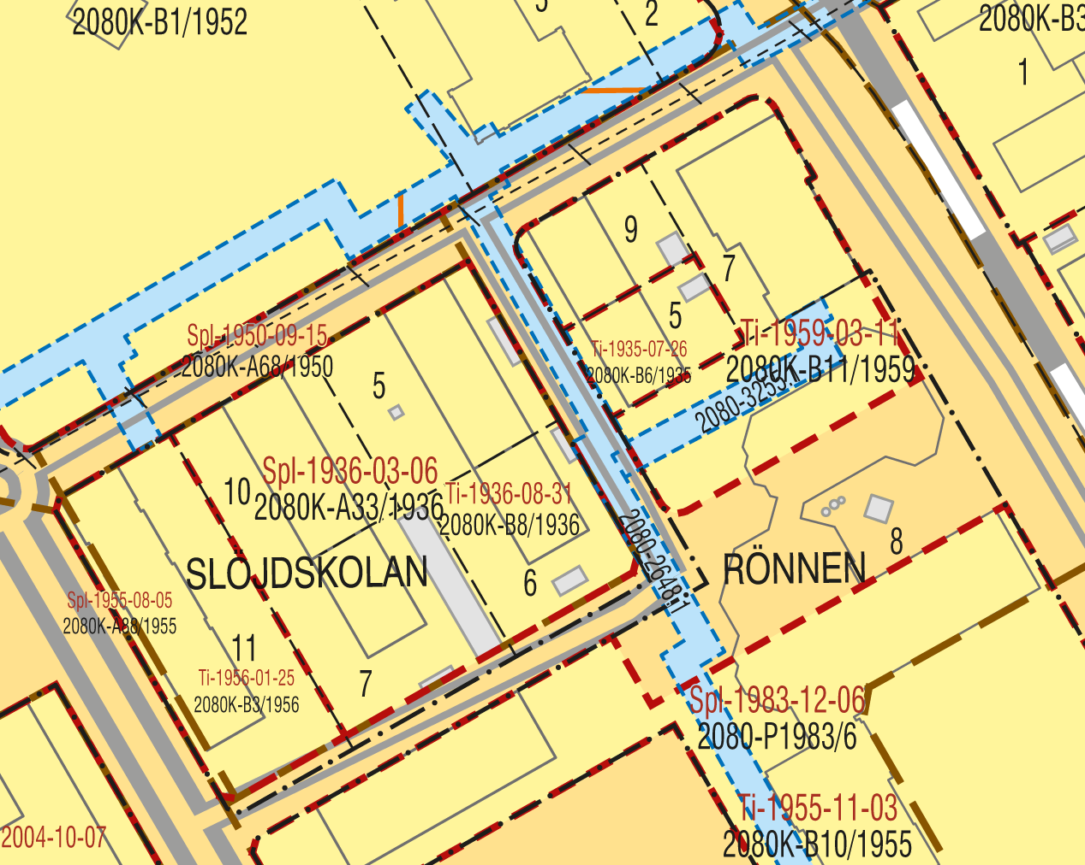

Slide 11
”Geometristöd i Utsikten” (best option)
Tailor-made solution for all municipal cadastral authorities
Based on ArcCadastre
Integrated in Lantmäteriet’s IT environment
All focus objects can be handled
Two-way communication between municipality and Lantmäteriet

Slide 12
”Bryggan” (second best option)
In-house developed updating interface from late 1990s
Two-step semi-automatic process including quality controls
Various complexity of the interface for each municipality
No standardised data formats
Development plans cannot be handled
One-way communication from municipality to Lantmäteriet
Separate updating of local copies of the cadastral map

Slide 13
Periodcial updating (to be phased out)
New cadastral survey data etc. gathered monthly
Data sent to a special updating team at Lantmäteriet
No standardised data formats
Semi-manual updating of the national database
Separate updating of local copies of the cadastral map

Slide 14
Ongoing activities of NDRK2017
Improving the second best application for continuous updating to handle all focus objects and to allow full data exchange (two-way communication)
Assisting the municipalities still using periodical or no updating to start using either of the two applications for continuous updating
Preparing for amendments to the registration legislation
… and discussing – as a separate initiative – future data exchange based on GML (no decision made yet)

Slide 15

KUF
Quality Development of Cadastral Data
Initiative originating from problems of missing data, contradictions, low accuracy etc. in the Real Property Register:
Improving existing textual and map information on property units and use rights
Special focus on property boundaries in the cadastral map
2011-2015, budget 2-3 million Euro per year
Cooperation with municipalities, Swedish Transport Administration and Swedish Forestery Agency
Previous project ”ALBIN”, 2006-2009: 10 million Euro.
Cost-benefit analysis showed good payback (factor 2.34)

Slide 16
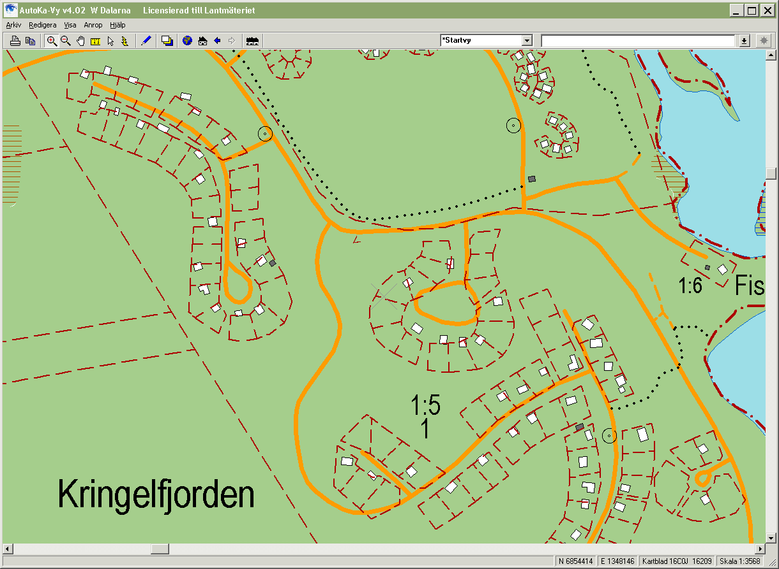
Before
Notes:
Området före vårt arbete kan se ut på följande sätt – Kan vara svårt att genom kartan bedöma vilken av fastigheterna som är bebyggd?

Slide 17
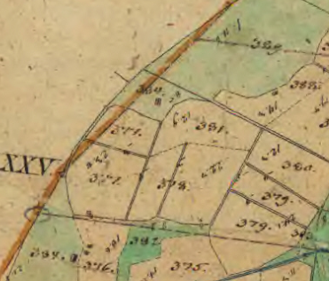
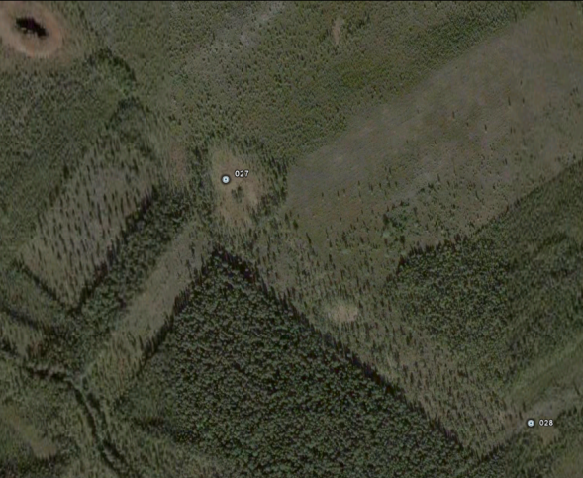
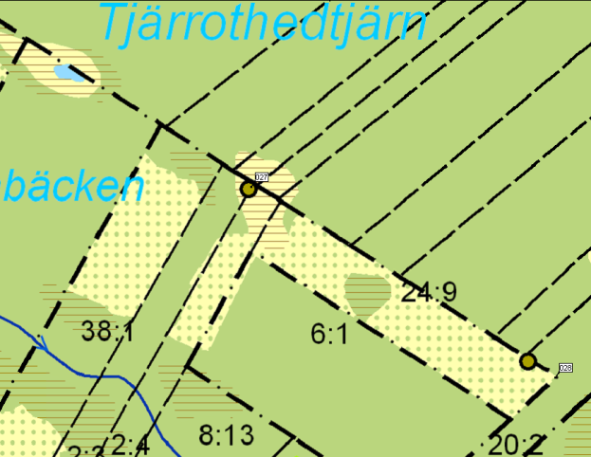
Mixed methodology for improving boundary data
Archive research, georeferencing, ortophoto comparison, field survey control…
… laser scanning, drones, crowd sourcing?

Slide 18
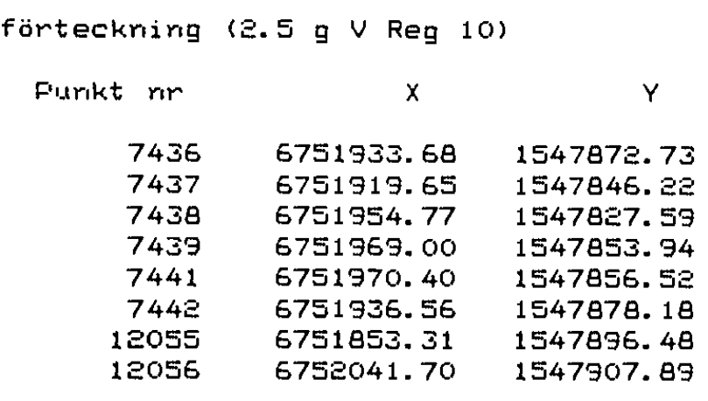
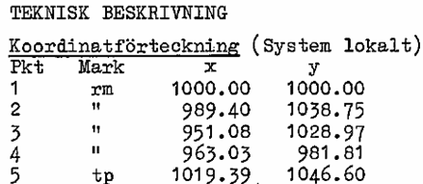
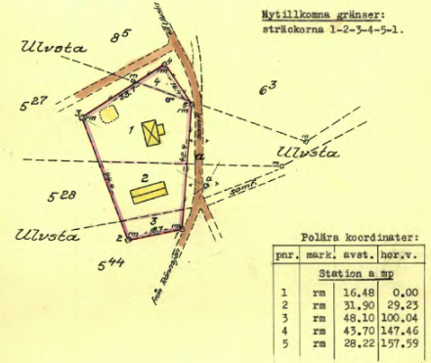
Archive research output
Information in cadastral documents
1. Coordinate lists connected to
the national geodetic network
>> direct use
Coordinate lists not connected to
the national geodetic network
>> GPS survey and transformation
Technical descriptions
>> Polar, Orthogonal and other constructions

Slide 19
Before
Notes:
Området före vårt arbete kan se ut på följande sätt – Kan vara svårt att genom kartan bedöma vilken av fastigheterna som är bebyggd?

Slide 20
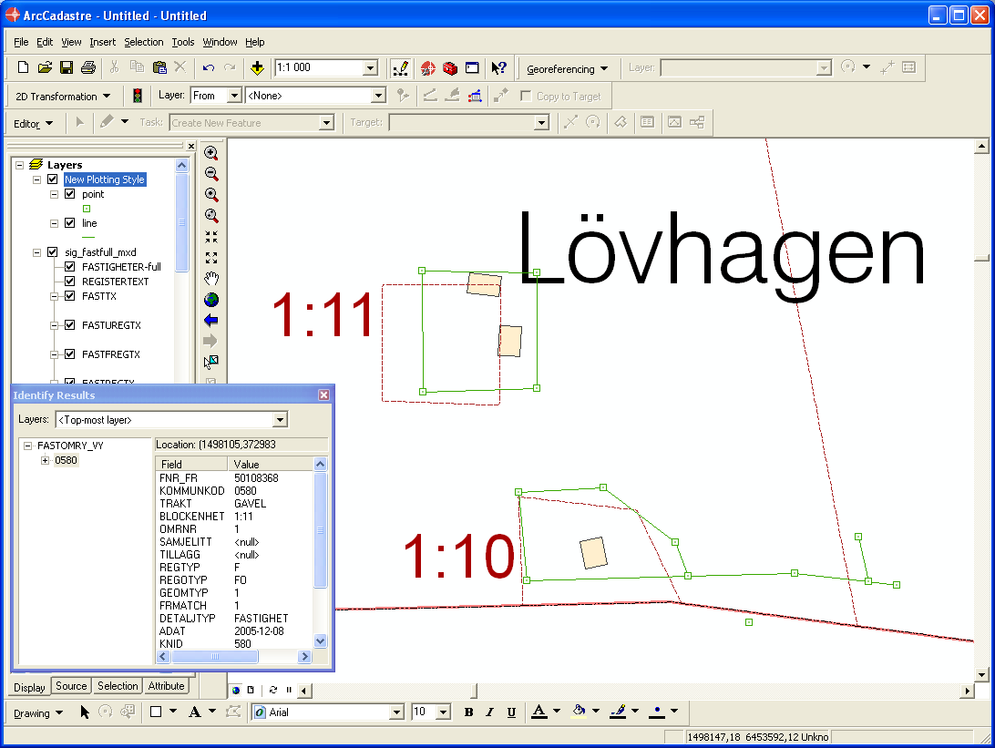
12 m

Slide 21
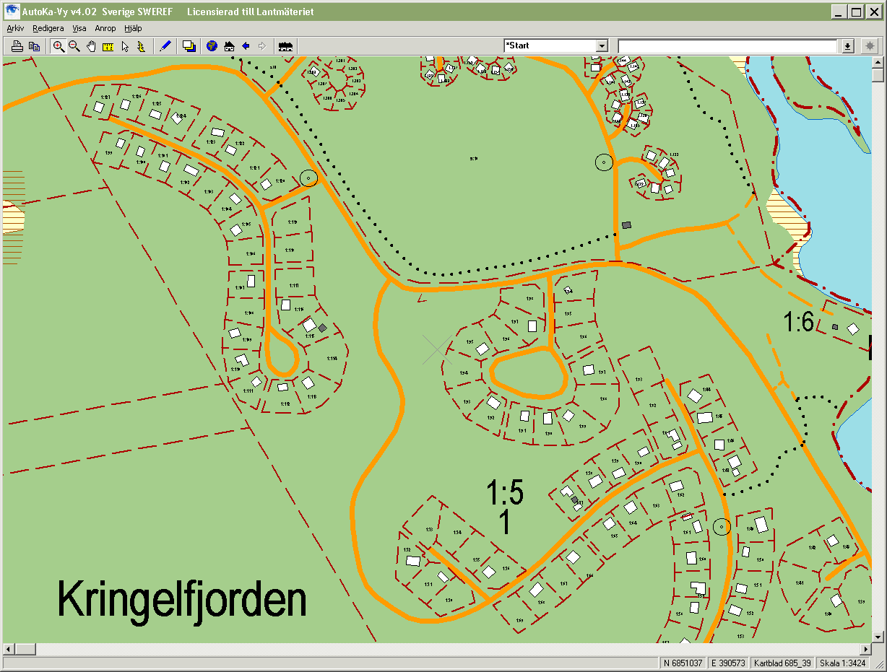
After

Slide 22
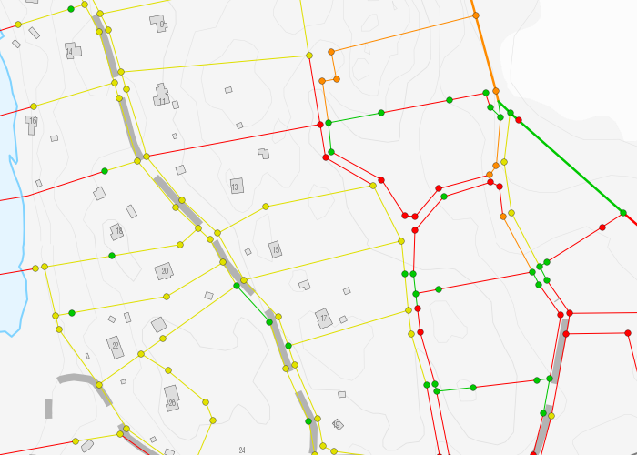
Boundary accuracy indication
Notes:
Lantmäteriet has a webservice that shows the quality of the boundary lines.

Slide 23
Thank you!
Notes:
Lantmäteriet has a webservice that shows the quality of the boundary lines.

